Slide 1

MOVIE INDUSTRY ANALYSIS
Prepared by: Brenda K., Saron W., Brenda C., Daniel O., Mark C.

Slide 2
Overview
This presentation is divided into 4:
Business Understanding
Data Understanding
Data Analysis
Conclusions

Slide 3
Business Understanding

Slide 4
We've decided to establish a new movie studio, but we're starting with little experience in film production.
Our responsibility is to investigate movies that are currently at the box office.
We'll then turn these insights into practical recommendations to assist the head of our new studio in determining which films we should focus on creating
The following questions will guide our analysis:

Slide 5
Objectives
Which genre performs the best at the box office?
Which studios are the top performing based on revenue?
What role does the foreign market play in the industry's overall performance?
What impact does the budget have on movie performance?
What is the optimal time of year to release a movie for maximum success?
Do certain languages have a broader audience reach?
Who are the top-performing directors and writers in the industry?

Slide 6
Methods
The methods used in the analysis are as follows:
Data Collection
Exploratory Data Analysis
Statistical Analysis - correlations, ANOVA
Data Cleaning
Data visualization
Linear regression
Seasonal Trend Analysis

Slide 7
Data Understanding

Slide 8
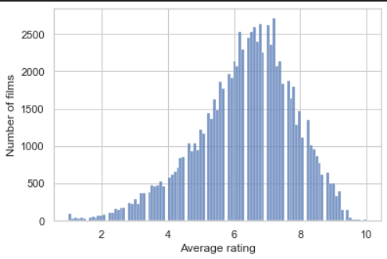
This is a histogram for average ratings across movies from 2010 to the present.

Slide 9
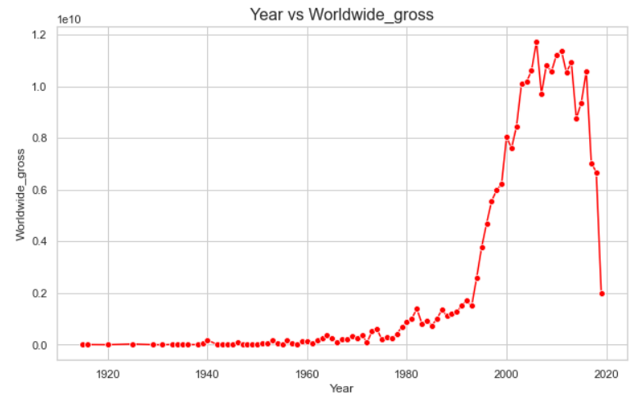
This is a line plot for Gross earnings over the years.

Slide 10
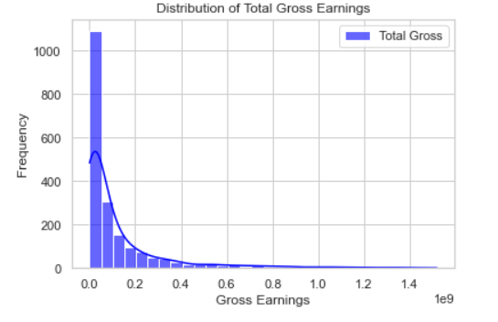
The earnings distributions are heavily right-skewed.
This means the majority of movies have lower gross earnings, while a small number of movies achieve very high earnings.

Slide 11
Data Analysis

Slide 12
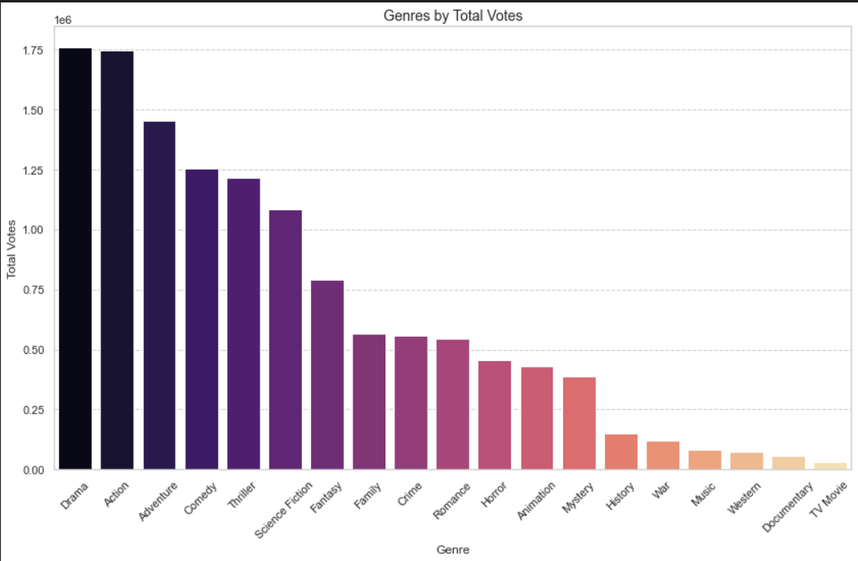
Which genre performs the best at the box office?
From this plot, we can see that Drama, Action and Adventure are the genres that receive the most votes.

Slide 13
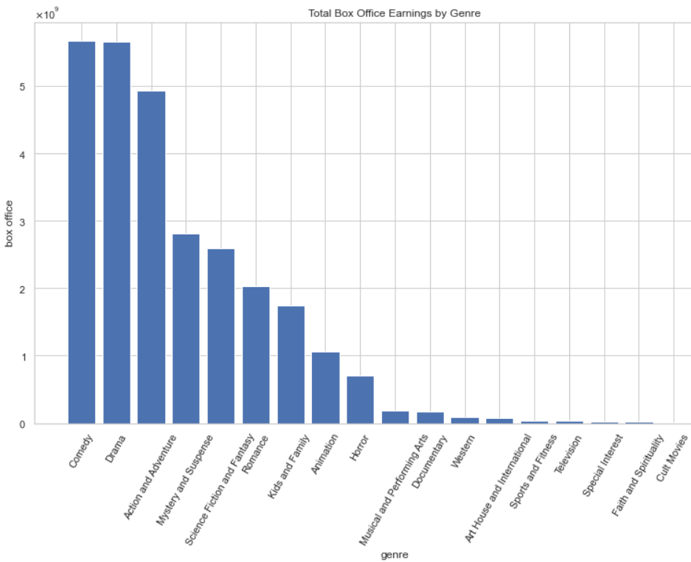
This plot shows that Comedy, Drama and Action and Adventure bring the highest earnings into the box office, indicating a high commercial appeal.

Slide 14
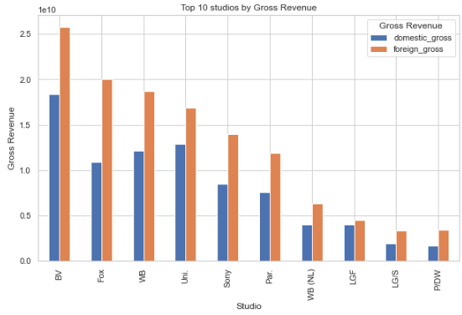
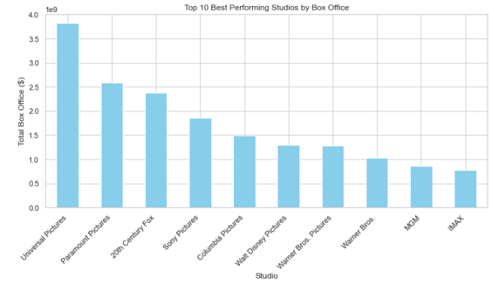
Which studios are the top performing based on revenue?
From the above plots, BV, Fox and Warners Bros are the top performing in terms of gross revenue. We can also see that foreign gross significantly drives revenue for studios.

Slide 15
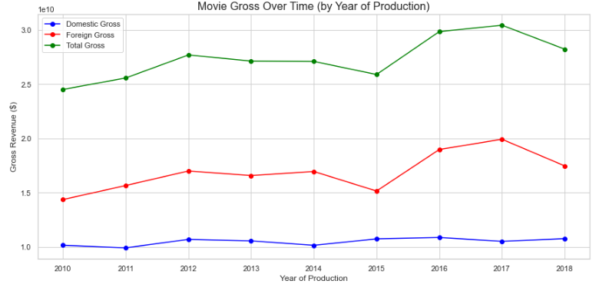
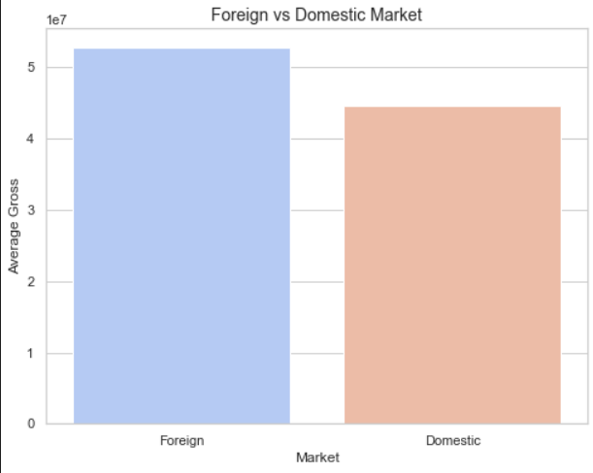
What role does the foreign market play in the industry's overall performance?
The foreign market contributes more to the industry. However, it is also noted that the domestic market contributes significantly to the success of the movies thus success in the domestic market leads to further success in the foreign market.

Slide 16
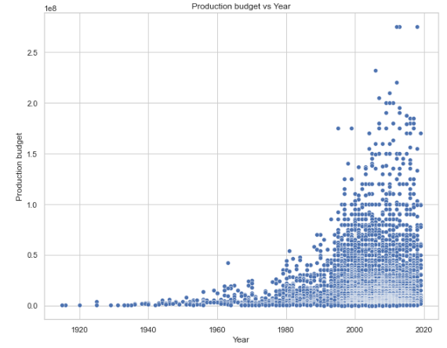
What impact does the budget have on movie performance?
We can clearly see that the production budget has been increasing over the years. This is may be because of the demand for high-quality visual effects.

Slide 17
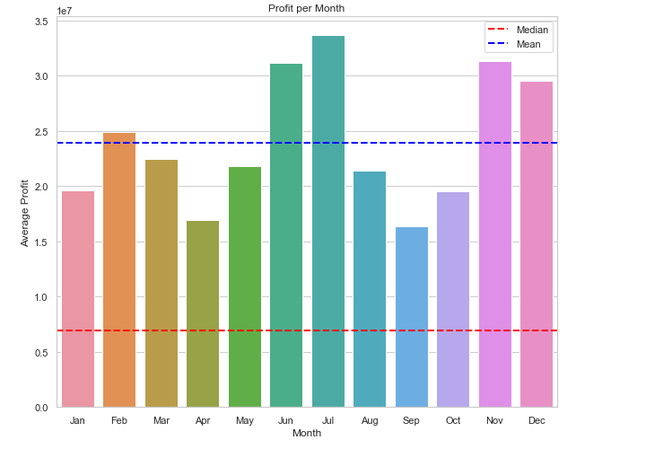
What is the optimal time of year to release a movie for maximum success?
The industry appears to perform better than average in mid year, that is June and July, and end year in November and December.

Slide 18
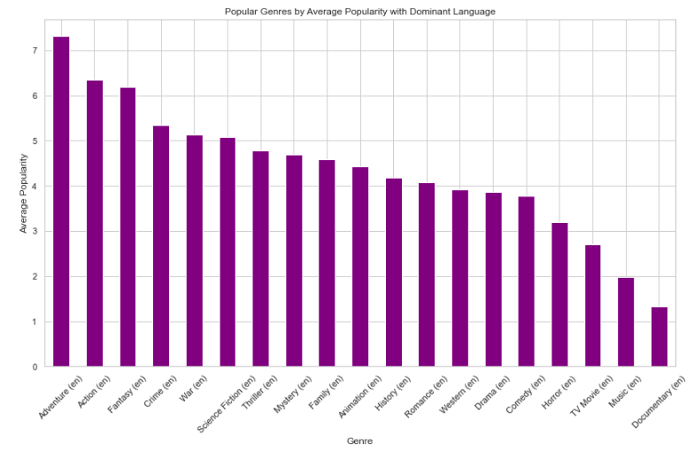
Do certain languages have a broader audience reach?
Based on the dominant language, English, adventure movies have a higher popularity compared to other genres

Slide 19
Conclusion
Based on the analysis, the most profitable genres are Drama, Comedy, Action, and Adventure.
Universal Studios, BV, and Sony are the top-performing studios. It is recommended that the client benchmark or collaborate with these studios to enhance their market presence.
The foreign market contributes approximately 55% of the industry's total revenue. Therefore, the client should highly consider the foreign market when planning and producing movies to maximize revenue potential.
For every dollar spent on production, an additional $1.4521 in gross revenue is generated. This highlights the importance of investing strategically in production budgets.
Movies released mid-year (June and July) and end-year (November and December) generate the highest revenue. It is advisable for the client to schedule movie releases during these months to capitalize on peak performance periods.

Slide 20
6. English is the dominant language in the movie industry, reaching the widest audience base compared to other languages. The client should consider producing movies primarily in English to maximize global reach and appeal.
7. a.) Gene Roddenberry, Vincent Gilligan, and Chris Morgan are among the top writers in the industry. The client is encouraged to explore hiring them for movie projects to ensure high-quality storytelling.
b.) Among the producers analyzed, Sergey stands out as the best performer. The difference between David and Paul is negligible, meaning selecting either one would likely yield similar results in movie performance.

Slide 21
The end!

Slide 22

Any Questions?

